Slide 1
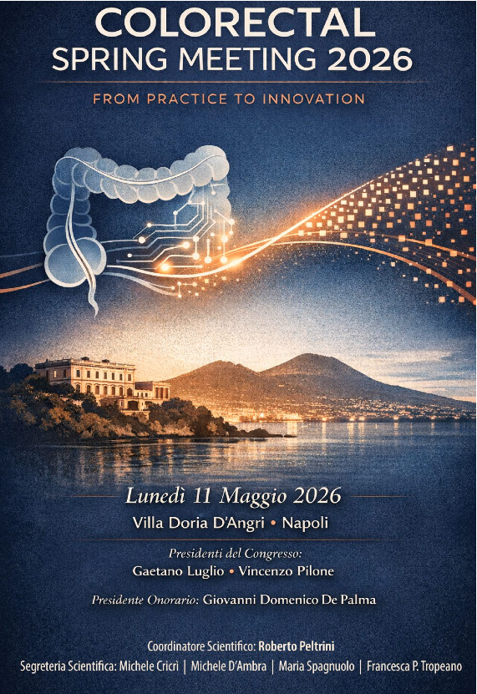

Perianal Crohn: are stem cells changing the game?
Silvio Laureti
Associate Professor of Surgery
IRCCS Sant’Orsola-Malpighi
University of Bologna

Slide 2
Perianal Complex Crohn’s disease
The Burden of the Disease
Over 150.000 pts in Europe and USA (10 % pediatric) – ≈ 12.000 in Italy
Costs: ≈ 25.000 € / year (direct and indirect)
Greatly diminished HR-QOL (pain, discharge, sexual relations,, work ….)
Biologic agents significantly modified the therapeutic algorithm (healing)
Surgical drainage and loose seton placement
Biologic therapy (sistemic or local)
Is the “first-line” therapy
BUT ……………………
Notes:
PARLIAMO DI OLTRE 150.000 PAZIENTI IN EUROPA E STATI UNITI, circa 12000 in italia, IL 10 % DEI QUALI IN Età PEDIATRICA, CHE RIFERISCONO UN SIGNIFICATIVO SCADIMENTO DELLA QUALITA’ DI VITA, LEGATO AL DOLORE, AL CONTINUO ED INCONTROLLABILE DRENAGGIO DI MATERIALE PURULENTO E FECALE, AI CONSEGUENTI LIMITI DI RELAZIONE SOCIALE, VITA SESSUALE E LAVORATIVA. IL FARDELLO DERIVA ANCHE DAI COSTI, QUANTIFICABILI IN CIRCA 25.000 EURO ALL’ANNO PER PAZIENTE PER SPESE DIRETTE ED INDIRETTE.
STORICAMENTE IL TRATTAMENTO CHIRURGICO DA SOLO MOLTO RARAMENTE PORTA ALLA GUARIGIONE, QUESTI PAZIENTI PER VARI MOTIVI HANNO UNA RIDOTTA CAPACITA’ DI RIPARARE IL DANNO TISSUTALE COSI CHE QUELLO CHE PUO FARE IL CHIRURGO E’ RISOLVERE LA SEPSI PER MIGLIORARE LA QUALITA’ DELLA VITA E CERCARE DI EVITARE O QUANTOMENO PROCRASTINARE LA NECESSITA’ DI CONFEZIONARE UNA STOMIA DEFINITIVA, RICHIO ANCORA OGGI QUANTIFICABILE ANCHE FINO AL 40 % DEI PAZIENTI.

Slide 3

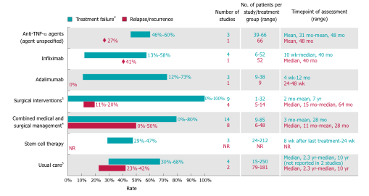
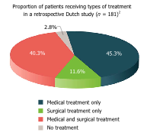
Alma Mater University - Bologna
Complex Perianal Crohn’s Disease
The Burden of the Disease
Multiple scenarios
Multiple therapeutic algorithms (“standard of care” not gold standard)
No definitive evidence that one option is clearly better than others
High rate of failure and relapses !!!
Significant risk of permanent stoma (12-42 %) ( anorectal stenosis, cavitating ulcers, proctitis ….)
Panes et al, WJG 2018
“USUAL CARE”
Varies among countries and includes both medical and surgical interventions

Slide 4
New Frontiers in perianal IBD
Multidisciplinary Care Models
Emerging Medical Therapies Biologics beyond anti-TNF
Personalized Medicine
Advances in Imaging
Surgical Innovations
REGENERATIVE MEDICINE
Cell-Based Therapies Mesenchymal Stem Cell (MSC) Therapy
Tissue Engineering
Biomaterials and Scaffolds
3D Bioprinting: Patient-specific grafts for anal tissue repair.
Hydrogels with embedded cytokines or exosomes.
Smart biomaterials that respond to local inflammation.
Combination therapies (e.g., MSCs + scaffolds + biologics).

Slide 5
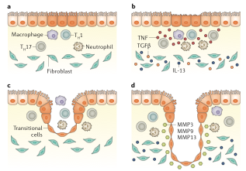
Regenerative Medicine for Immune-mediated Diseases (IMIDIs)
Rationale for use in perianal CD
IMMUNOMODULATORY ACTION
Dampen the inflammatory response:
- reducing activation of CD4 T lymphocytes
- promote the formation of regulatory T-cells
Dampen the proinflammatory action of dendritic cells
Anti inflammatory action on Bcells reducing the activation and production of antibodies and reducing the toxicity of natural killers cells
REGENERATIVE CAPABILITY
i.e. can transform into fibroblasts to help form a scar…

Slide 6
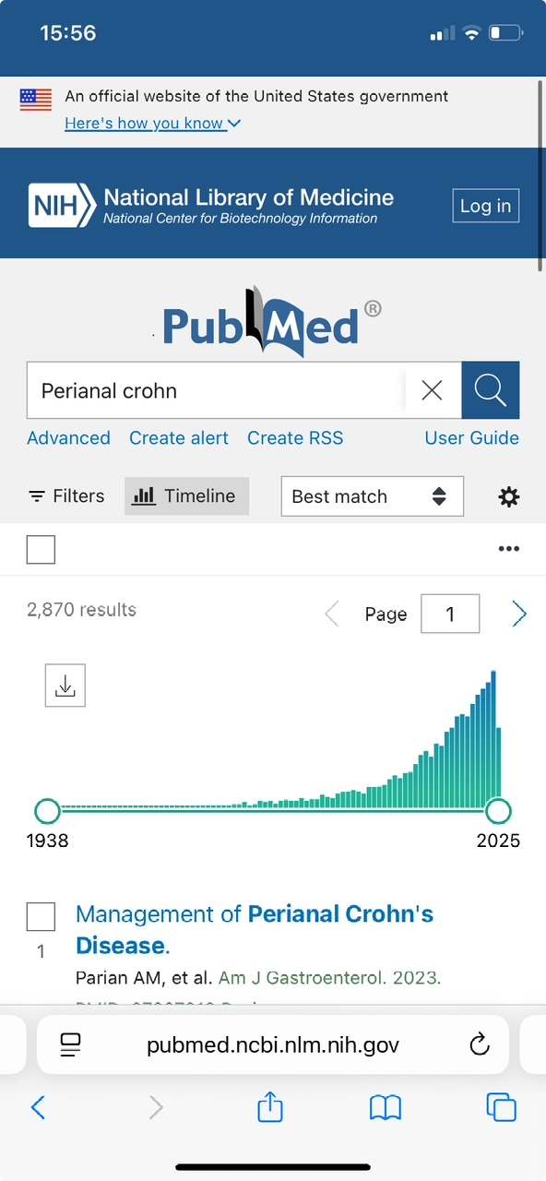
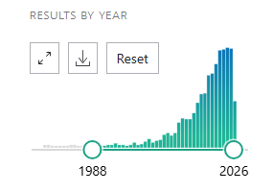
A “niche topic” ?
Rising Tide of Research and Scientific Publications
Perianal Complex Crohn’s Fistulas
Perianal Complex Crohn’s Fistulas and MSC’s / Regenerative Medicine
3,055 results
(2870 on CD fistula)
2003
2026
Pubmed research results on “perianal complex fistula”
Pubmed research results on “perianal complex fistula and MSCs”

Slide 7
Growth of Regenerative Medicine Research in Perianal Fistula (2010–2025)
Non è solo crescita quantitativa:
2010–2014 → fase pionieristica
2015–2019 → trial clinici e proof-of-concept
2020–oggi → meta-analisi, standardizzazione, nuove terapie (exosomi)
già nel 2019 esistono meta-analisi strutturate
oggi abbiamo umbrella review e analisi avanzate

Slide 8
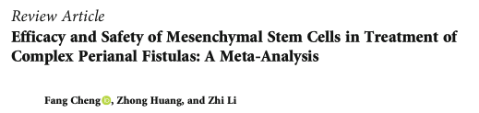
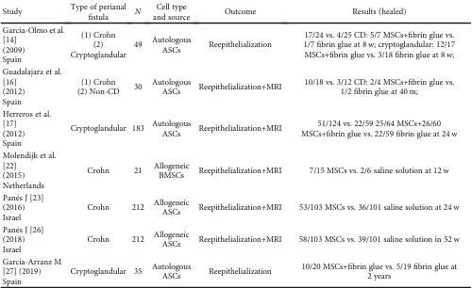

Stem Cells International, 2020
7 RCTs (out of 1080 studies !) with 730 pts
Risk of Bias
^{Using “reepithelialization”:} 61.4% versus 20.5%; (OR = 5:92; P = 0:02)
Using MRI (363 pts): 49.3% versus 36.6%
^{(OR = 1:77; P = 0:0006).}

Slide 9

Techniques in Coloproctology, 2025
43 studies (11 RCT) incorporating 1160 patients (CD (30 studies) and cryptoglandular disease (12 studies)
From adipose tissue (34 studies) or bone marrow (6 studies).
Median f.u. 12 months
COMBINED remission in 24 studies, CLINCAL remission in 19 studies
Closure of the internal fistula orifice was performed in 32 studies and was associated with a pooled healing rate of 57.1%
Overall (combined and clinical) pooled healing rate was 58.1%

Slide 10
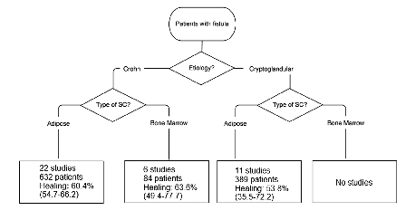
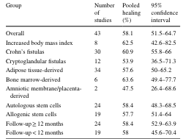
Techniques in Coloproctology, 2025)
- No serious adverse events
Limitations
small number of patients
fair quality of the included studies
significant heterogeneity in the patient population,
method of application of stem cells,
definition and assessment of healing

Slide 11
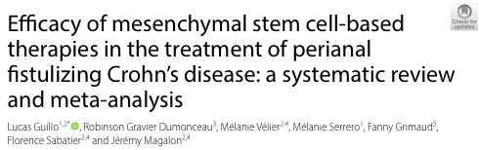
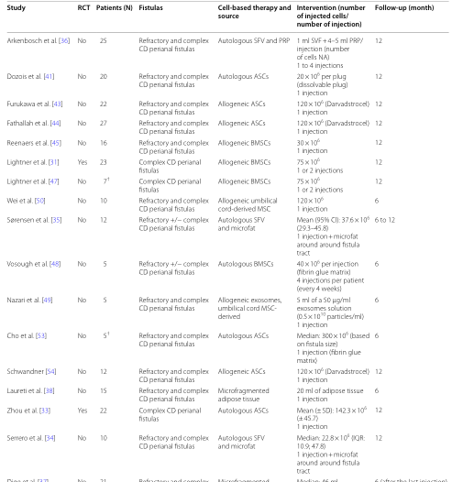
Guillo L. et al
Stem Cell Research & Therapy (2025)
25 studies included in the meta-analysis, enrolling 596 patients with perianal fistulizing CD.
Results
Combined remission rate at 3, 6 and 12 months were 36.2%, 57.9% and 52% respectively.
MSC-based therapies demonstrated a significant effect in achieving combined remission compared to placebo
At 6 months, the combined remission rate was 57.2% for adipose-derived stem cells (ASCs) and 55.7% for bone marrow-derived stem cells (BMSCs) (p=NS)

Slide 12
Guillo L. et al
Stem Cell Research & Therapy (2025)
25 studies included in the meta-analysis, enrolling 596 patients with perianal fistulizing CD.
Limitations
Significant heterogeneity among the studies regarding the dose of cells injected, the number of injections, the source of cells, surgical strategy and the use of a matrix.
Only 4 were RCTs, which reduces the certainty of evidence of the results.
At last, the number of patients in each study was limited, ranging from 5 to 33, excepted for the study of Panés et al. [11] which included 212 patients.

Slide 13
Evidence Overview
efficacia nei casi refrattari
sicurezza confermata
Limiti
Eterogeneità studi
Endpoint variabili
Risposta non uniforme
Criticità principale:
assenza di standardizzazione chirurgica
terapia validata, non più sperimentale

Slide 14
Flaws OF MSCs Cell Therapies
Despite the encouraging results, utilization in daily clinical practice is limited by:
Need of GMP grade (good manufacturing practice) laboratories
Time interval (several weeks) required for in vitro cell expansion, which represents a costly and time-consuming approach
Complex restrictions related to cell expansion and extensive manipulation.
These limitations spurs the need to develop novel regenerative approaches to isolate autologous adipose tissue containing MSCs, which should possibly be
“one-step”,
minimally invasive,
not requiring any enzymatic treatment,
affordable
compliant with the regulatory panorama..

Slide 15
AUTOLOGOUS MICROFRAGMENTED ADIPOSE TISSUE (TAAM) INJECTION
^{Obtained with} ^{minimal} ^{manipulation}
No expansion and/or anzymatic treatment
^{Affordable,}
Minimally invasive, no risk of sphincteric damage,
can be carried out in a day-surgery setting.

Slide 16
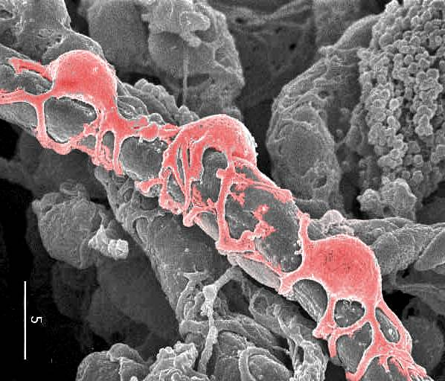
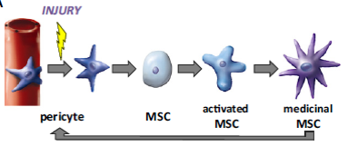
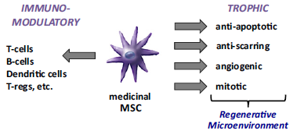
AUTOLOGOUS MICROFRAGMENTED ADIPOSE TISSUE (TAAM) INJECTION
LIPOGEMS - TAAM
Pericyte
The Lipogems product represents a biodynamic filler containing intact vasculo-stromal niches rich in pericytes, without any loss of the architecture and vitality of its cellular elements. The purpose of the pericyte is not that of transdifferentiation, which is absent, but is to promote a microenvironment that allows the natural inclination of the receiving tissue to self-heal to emerge.
The pericytes and the cells derived from them therefore do not represent elements capable of assuming phenotypic orientations different from those of the starting tissues, but they actually become facilitators of a self-healing process

Slide 17

Alma Mater University - Bologna
SUGGESTED ALGORITHM
1° step: Sanitization of perianal sepsis
Just seton placement ?

Slide 18
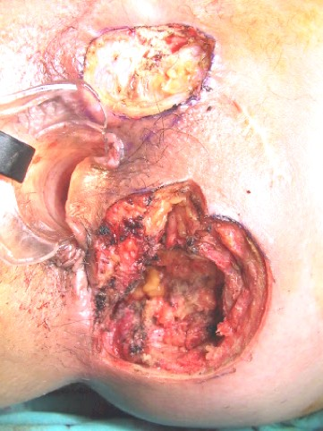
Alma Mater University - Bologna
SUGGESTED ALGORITHM
1° step: Sanitization of perianal sepsis
“Cone-like” Fistulectomy and loose seton placement
BRIDGING TREATMENT
Convert an acute uncontrolled situation into a potentially curative situation

Slide 19
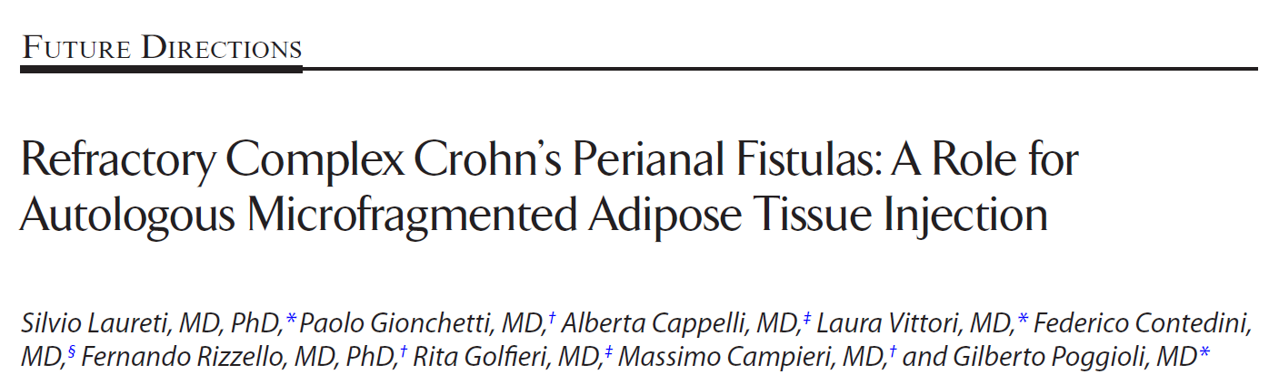
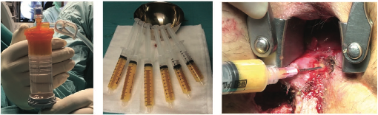
IRCCS S. Orsola - University Hospital, Bologna - Italy
IBD, March 2020
15 pts with persistent complex fistulizing PCD after the bio-surgical approach and subsequent surgical “rescue” repair
After local surgical drainage of the perianal disease, 20 cc of micro-fragmented adipose tissue were injected circumferentially into the submucosa surrounding the internal fistula orifice
(CARRIED OUT IN DAY SURGERY SETTING !!!)
Clinical outcomes were determined at 24 week follow-up assessing success rate, defined as ”combined clinical and radiological remission”
(absence of residual collections > 3 mm ..)

Slide 20
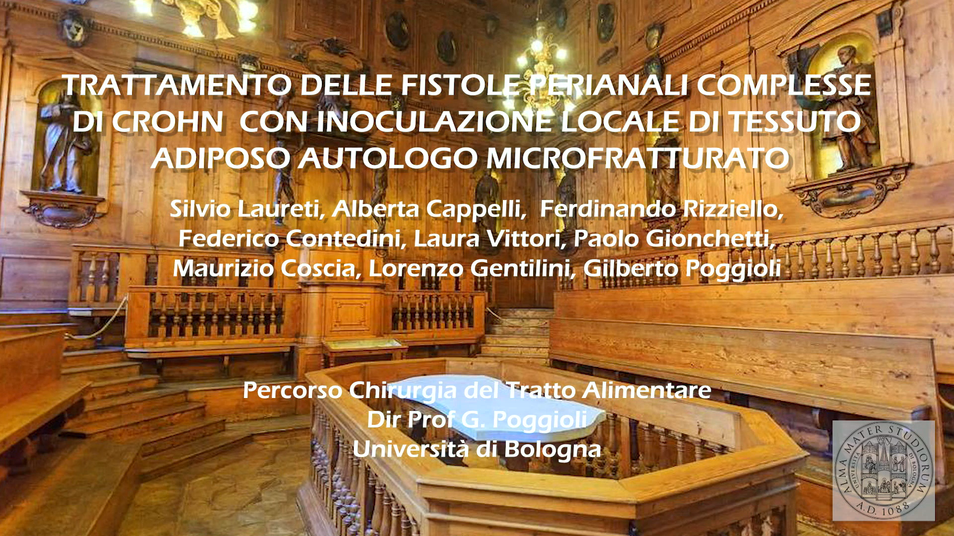
THE PROCEDURE
Alma Mater University - Bologna

Slide 21
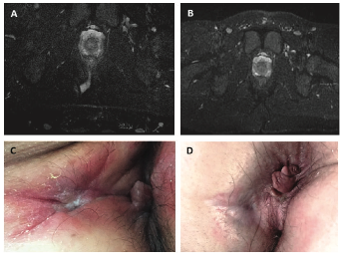
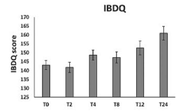
IRCCS S. Orsola - University Hospital, Bologna - Italy
IBD, March 2020
RESULTS
10 /15 pts (66.7%) with COMBINED REMISSION (healed)
14 /15 pts (93.3%) with CLINICAL REMISSION (not draining fistulas at gentle finger compression)
Notes:
21

Slide 22
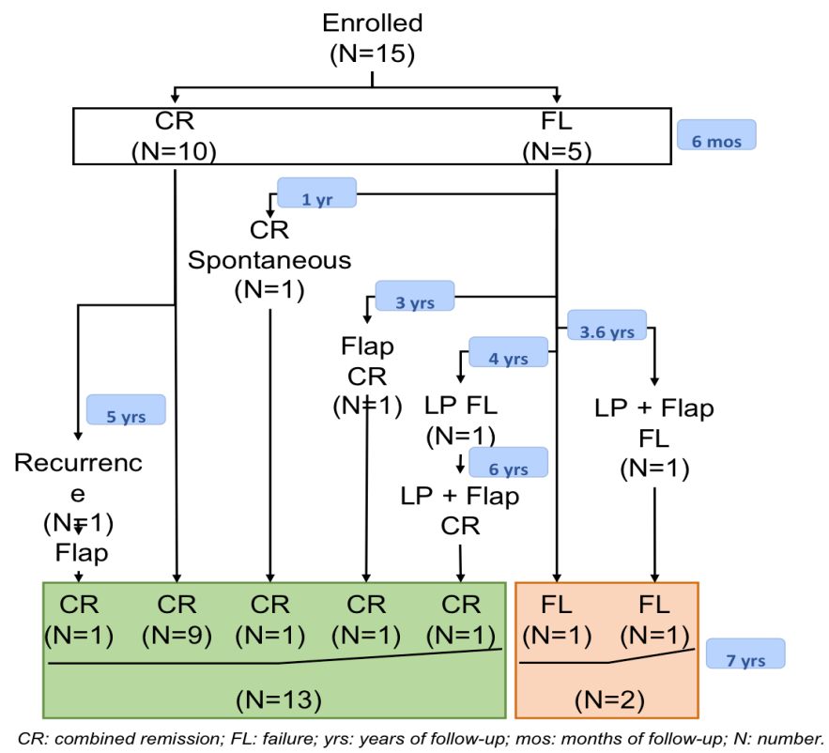
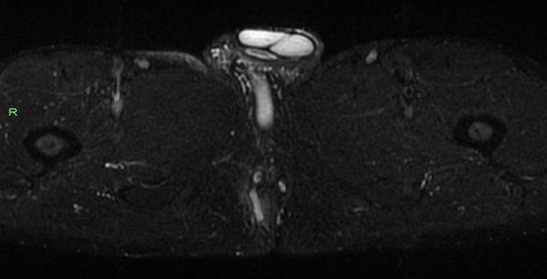
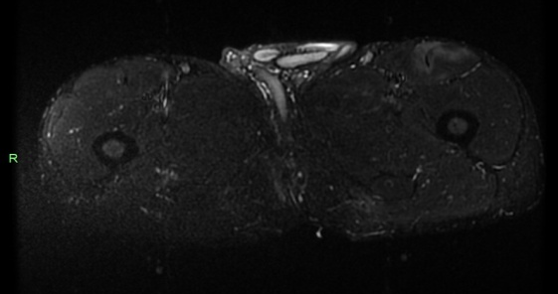
Autologous Microfragmented Adipose Tissue Injection in Refractory Complex Crohn’s Perianal Fistulas: long-term results at 6.7 years mean follow-up
Laureti S, Cappelli A, Isopi C, Gentilini L, Villani R, Sorbi G, Rizzello F, Menon A, Doussias, N, Gionchetti P, Poggioli G
IBD 2024
Recurrence rate: 10 % (6,6%)
1 delayed healing
Reoperation in 4 pts: (1 or 2 procedures) flap, flap + lipogems,)
Final healing rate: 86.6%

Slide 23

Best Abstract Presentation Prize @ UEG Week Congress – Berlino, Ottobre 2025
Presented @ XXI ECCO Congress –
Stoccolma Febbraio 2026
Included in “Best of IBD and Nutrition of UEG week 2025” Presentation @ DDW – Chicago May 2026
TREATMENT OF CROHN'S COMPLEX PERIANAL FISTULAS WITH MICRO-FRAGMENTED AUTOLOGOUS ADIPOSE TISSUE INJECTION:
AN ITALIAN MULTICENTER RANDOMIZED CONTROLLED TRIAL (ATTIC)
Silvio Laureti
M.D., Associate Professor of Surgery
Surgery of Alimentary Tract and Emergencies
IRCCS S. Orsola-Malpighi , University of Bologna. Italy

Slide 24
The ATTIC STUDY
STUDY DESIGN AND OUTCOMES
Study Design
Study Primary Outcome
Secondary Outcomes
A prospective, randomised, double-blind, controlled trial conducted across six Italian hospitals, with 80 participants.
COMBINED REMISSION @ 24 weeks
CLINICAL REMISSION @ 24 weeks
Absence of drainage upon gentle digital compression of all external openings that were draining at baseline and
absence of abscesses >3 mm associated with the treated perianal fistulas on pelvic MRI at 24 weeks p.o.
Closure of alla external openings that were draining at baseline despite gentle digital compression, with the presence of abscess collections >3 mm on MRI
IRCCS S. Orsola-Malpighi Bologna
IRCCS - Univerità Cattolica del Sacro Cuore, Rome
University Hospital L. Sacco, Milan
AOU Policlinico, ,University of Naples,
Careggi Hospital, University Florence
Humanitas Reserch Hospital, Milan
Time to healing
Quality of Life (IBDQ, WPAI, PDAI)
CRP
Safety (SAE)
Notes:
Based on these results we then completed this prospective randomized double blind controlled trial together with other 5 high volume italian centers, The primary ouctome was rate of combined remission defined as combination of clinical and radiological remission, with the stringent radiologic definition af absence of residual abscesses greater than 3 mm. Secondary outcomes were measurement of clinical remission and response, quality of life assessment, CRP dosage and time to healing

Slide 25



The ATTIC STUDY
STUDY DESIGN AND OUTCOMES
Treatment Group: Surgical Drainage & MFat Transplant
Study Primary Outcome
Phase 1: Adipose Tissue Harvesting
COMBINED REMISSION @ 24 weeks
A board-certified plastic surgeon performed manual liposuction using a 13G cannula and a 20 mL VacLok syringe, yielding 60-100 mL of lipoaspirate.
Absence of drainage upon gentle digital compression of all external openings that were draining at baseline and
absence of abscesses >3 mm associated with the treated perianal fistulas on pelvic MRI at 24 weeks p.o.
Phase 2: Lipoaspirate Processing
Immediately, the adipose tissue was processed with the system to create minimally manipulated MFat,, ready for transplantation.
Phase 3: Surgical Drainage & MFat Injection
Following EUA, a "cone-like" partial fistulectomy, was performed carefully preserving the sphincter plane.
Then, 15-20 mL of MFat were circumferentially injected into the submucosal tissue and along the fistula tract
Notes:
Based on these results we then completed this prospective randomized double blind controlled trial together with other 5 high volume italian centers, The primary ouctome was rate of combined remission defined as combination of clinical and radiological remission, with the stringent radiologic definition af absence of residual abscesses greater than 3 mm. Secondary outcomes were measurement of clinical remission and response, quality of life assessment, CRP dosage and time to healing

Slide 26
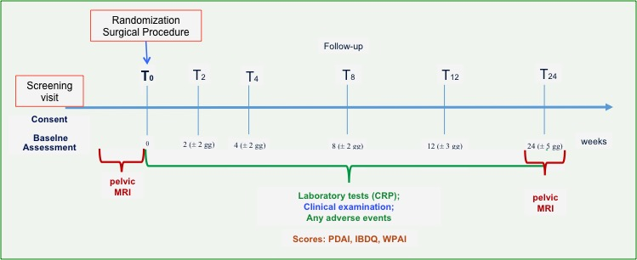
The ATTIC STUDY
ELGIBILITY CRITERIA
Presence of complex perianal fistulizing disease refractory to conventional therapy, defined as a combination of surgical drainage of sepsis and local/systemic anti-TNF-α administration for at least 12 months.
Key Inclusion Criteria
Age ≥ 18 years
Diagnosis of Crohn’s disease confirmed by instrumental and histological assessments.
Provision of written informed consent after having received and understood all relevant information regarding active participation in the study.
Ability to comprehend the study requirements and to comply with study procedures throughout the entire duration of the study.
Key Exclusion Criteria
Presence of more than one internal opening and more than three external openings.
Presence of ileostomy or colostomy.
Presence of ano-/recto-vaginal fistulas.
Active infections with HIV, hepatitis C virus (HCV), hepatitis B virus (HBV), or tuberculosis.
Abdominal localization of Crohn’s disease that may require general surgery during the study period.
Active oncological or lymphoproliferative disease
Conditions preventing the safe harvest of an adequate amount of lipoaspirate (≥ 60 cc).
Any clinical condition that, in the opinion of the investigator, may compromise the success of the surgical procedure or the follow-up.
Pregnancy or breastfeeding.
Concomitant treatments were permitted at a stable dosage for the duration of the study
All the clinical assessments were performed by independent co-investigators who were not involved in surgical procedures and blinded to patient’s group allocation. The radiologist evaluating the MRI scans was also blinded to patient allocation
Notes:
Were enrolled patients with comples perianal fistula in crohn’s disease refractory to combination of surgical drainage and biologic terapy for at least one year.
Were excluded patients with more than one internl orifice and 3 external orifices, patients with oostomy, rectovaginal fistula
You can see the timeline of the study with baseline magnetic resonance and final clinical and radiological assessment at 24 weeks.
Concomitan treatment, incuded biologics, were permitted during the study,
Both clinical and radiologic evaluation were conducted by independent coinvestigators blind to the patient’s allocation

Slide 27
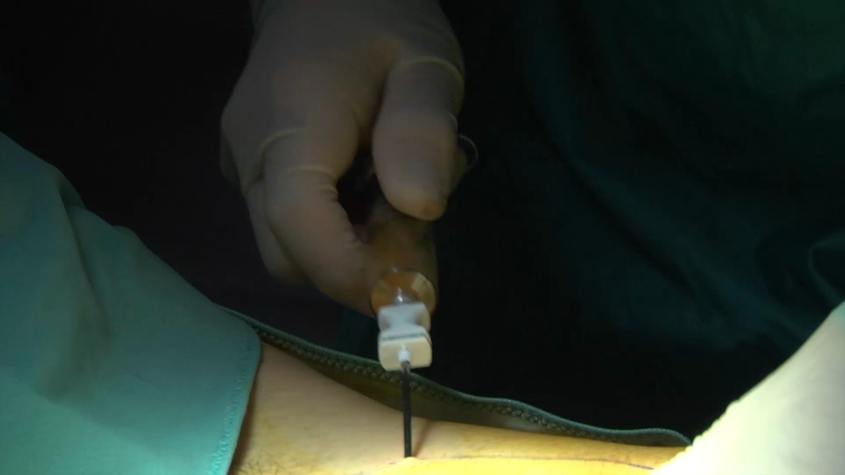
The ATTIC STUDY
SURGICAL PROCEDURES
Treatment Group: Surgical Drainage & MFat Transplant
Control Group: Sham Procedure
Phase 1: Adipose Tissue Harvesting
A 6-0 absorbable suture will be applied to the skin of the thigh, and the skin will be gently pinched to simulate the liposuction procedure.
A board-certified plastic surgeon performed manual liposuction using a 13G cannula and a 20 mL VacLok syringe, yielding 60-100 mL of lipoaspirate.
Following EUA, a "cone-like" partial fistulectomy, was performed carefully preserving the sphincter plane.
Phase 2: Lipoaspirate Processing
The internal mucosal opening was closed using absorbable 2/0 polyglactin sutures, and the closure integrity was confirmed by injecting 10 mL of sterile saline through the external opening under pressure.
Immediately, the adipose tissue was processed with the system to create minimally manipulated MFat,, ready for transplantation.
Phase 3: Surgical Drainage & MFat Injection
Following EUA, a "cone-like" partial fistulectomy, was performed carefully preserving the sphincter plane.
Then, 15-20 mL of MFat were circumferentially injected into the submucosal tissue and along the fistula tract
Notes:
At time 0 the patients in group treatment were submitted for harvesting by liposuction of adipose tissue, which was then processed to create minimally manipulated injeactable tissue. A cone like fistulectomy of all the fistula tracts was performed to sanitize the perianal area and 15 to 20 ml of fat was injected submucosally around the internal orifice and along the fistula tract. For control patients, lipoaspiration was mimicked by placing a suture to the skin of the tigh and the skin was pinched, After cone like fistulectomy 10 ml of saline solution were injected a a 2-0 suture plased to close the internal orifice

Slide 28
The ATTIC STUDY
RESULTS – Primary Outcome
66 pts completed the study (33 per Group) out of 80 pts randomized
%
p < 0.005
Combined remission rate was significantly higher in Treatment group
(57.6% vs 18.2%)
Silvio Laureti
Notes:
Moving directly to the result,among the 66 patients who completed the study, we observed a significantly higher combined remission rate in the treatment group , reaching 57,6 percent. Success is promising even in patients with multiple external orifice. Median time to healing was approximately one month in the treatment group and 2 monts in controls.

Slide 29
The ATTIC STUDY
RESULTS – Post-hoc Univariate and Multivariate Logistic Regression
At univariate logistic regression had significantly worse results
age ≥ 45 yrs
BMI = underweight
At multivariate logistic regression
age ≥ 45 yrs
Silvio Laureti
Notes:
Post-hoc unvariate analysis showed significantly worse outcomes in patients older than 45 yrs and in patients obese and underweight, while age was the only independent predictor of outcome in multivariate analysis

Slide 30
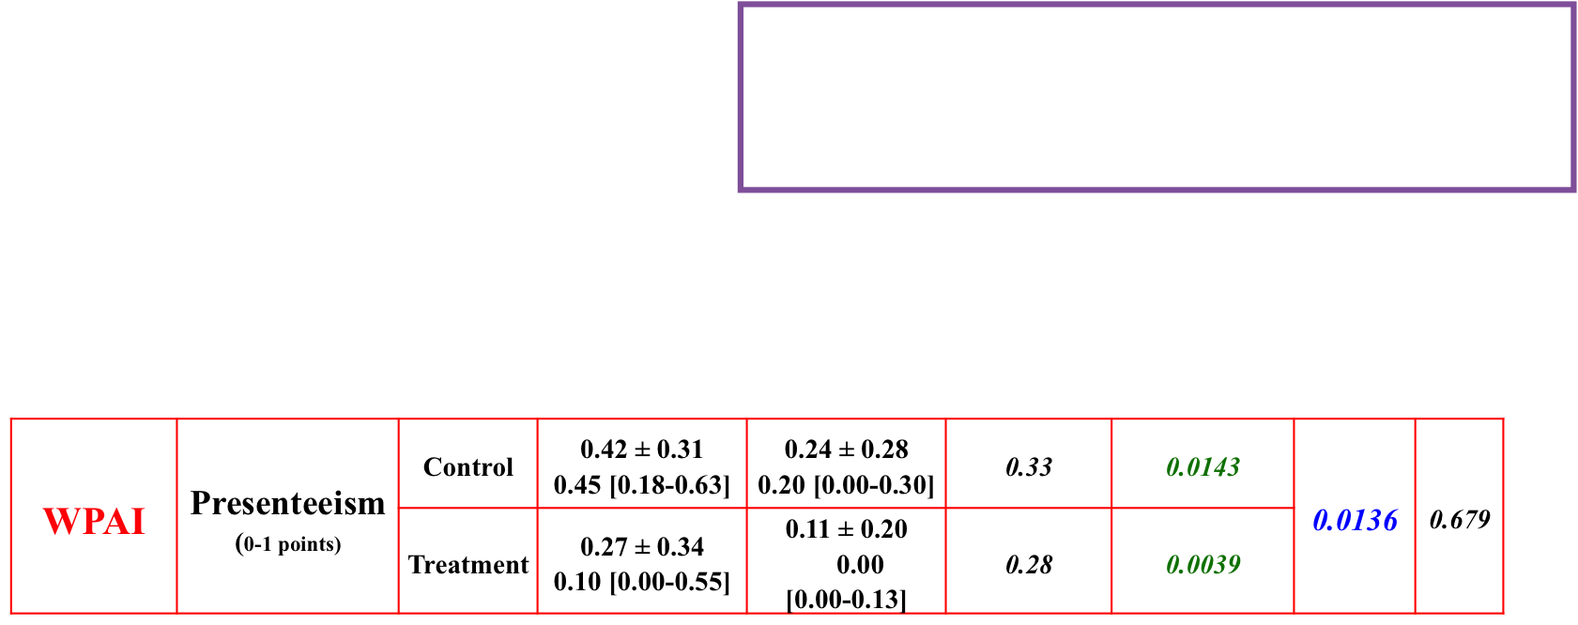
The ATTIC STUDY
RESULTS – Secondary Outcomes
Baseline
24 weeks
CLINICAL REMISSION
%
CRP (mg/L) | Control | 9.85 ± 14.90 3.85 [1.78-12.08] | 7.83 ± 11.29 4.35 [1.43-9.48] | 15.44 | 0.8710 | 0.8860 | 0.444
 | Treatment | 12.88 ± 24.66 3.64 [1.41-10.40] | 7.39 ± 11.91 4.55 [1.65-6.95] | 22.11 | 0.3865
PDAI (0-12 points) | Control | 8.76 ± 3.79 8.00 [6.00-11.00] | 4.79 ± 3.81 4.00 [2.00-6.00] | 4.68 | < 0.0001 | 0.1904 | 0.601
 | Treatment | 6.85 ± 3.20 7.00 [4.00-9.00] | 3.42 ± 2.64 4.00 [1.00-5.00] | 3.69 | < 0.0001
IBDQ (0-224 points) | Control | 151.94 ± 34.70 156.00 [131.50-174.50] | 170.39 ± 34.40 173.00 [150.00-193.50] | 26.19 | 0.0001 | 0.5301 | 0.638
 | Treatment | 160.27 ± 36.28 165.00 [137.00-184.50] | 175.27 ± 36.95 176.00 [161.00-207.50] | 32.82 | 0.0135
p < 0.005
Silvio Laureti
Notes:
Regarding secondary outcomes, clinical remission rates were also significantly higher in the treatment group . Quality of life, disease-related scores and CRP levels significantly improved from the baseline in both groups, without significant differences between-group at 24 weeks.
In the WPAI assessment, presenteisms showed a significant impprovement in patients treated with fat injection

Slide 31
The ATTIC STUDY
RESULTS – Secondary Outcomes – Adverse Events
 | Treatment group | Control group | Overall | p-valueª
No. of patients reporting AEs | 4 (10.8) | 3 (8.1) | 7 (9.5) | 0.691
Events: |  |  |  | 0.370
postoperative hemianopsia * | 1 (25.0) | 0 (0.0) | 1 (14.3)
fever | 0 (0.0) | 1 (33.3) | 1 (14.3)
inner thigh paresthesia | 1 (25.0) | 0 (0.0) | 1 (14.3)
abdominal disease flare-up | 1 (25.0) | 2 (66.7) | 3 (42.9)
soiling (minor incontinence) | 1 (25.0) | 0 (0.0) | 1 (14.3)
Seriousness: |  |  |  | 0.270
not serious | 3 (75.0) | 1 (33.3) | 4 (57.1)
serious | 1 (25.0) | 2 (66.7) | 3 (42.9)
Relation to the treatment: |  |  |  | 0.233
certain | 0 (0.0) | 0 (0.0) | 0 (0.0)
probable | 0 (0.0) | 0 (0.0) | 0 (0.0)
possible | 2 (50.0) | 0 (0.0) | 2 (28.6)
impossible | 0 (0.0) | 1 (33.3) | 1 (14.3)
unrelated | 1 (25.0) | 2 (66.7) | 3 (42.9)
unknown | 1 (25.0) | 0 (0.0) | 1 (14.3)
Required treatment: |  |  |  | 0.809
no | 1 (25.0) | 1 (33.3) | 2 (28.6)
yes | 3 (75.0) | 2 (66.7) | 5 (71.4)
Kind of treatment: |  |  |  | 1.000
surgical | 0 (0.0) | 2 (100.0) | 2 (40.0)
conservative | 3 (100.0) | 0 (0.0) | 3 (60.0)
10% of 33 patients in the Treatment group and 8,1% of 33 in the Control group experienced AEs
1 (3%) of patients in the Treatment group versus 2 (6%) in the Control group experienced serious adverse events.
2 pts (6%) in the Treatment group and 2 (6%) of 33 in the Control control group withdrew from the study because of TAEs (unrelated to treatment)
* In a 42 yrs-old female patient with cerebral AVM
Silvio Laureti
Notes:
4 patients in the treatment group and 3 in the control group experienced adverse events, Only 1 was serious in treatment group represented by a case of hemianopsia in a female patient with a cerebral arterovenous malformation

Slide 32
The ATTIC STUDY
CONCLUSIONS
Combination of complete surgical drainage and TAAM administration is an effective treatment for complex perianal fistulas in patients refractory to conventional treatments
Injection of microfragmented adipose tissue is minimally invasive, easy on regulatory (transplant not drug), affordable and can be carried out in day-surgery setting.
TAMM administration did not produce any safety signals in patients in this study.
Limitations of the study: - absence of certain fistula types (rectovaginal, multiple internal orifices)
        - presence of ongoing biologic therapy.
Future research lines
Long term efficacy and safety (Tumorgenicity)
Repeated injection
Extend the indications (naive patients,recto-vaginal fistulas, pediatric, more than one internal orifice….)
Change the algorithm: First-line treatment?
Notes:
In conclusion, our findings confirm that combining surgical drainage with TAAM administration is an effective treatment for complex perianal fistulas in Crohn’s disease patients who did not respond to conventional therapy. Importantly, TAAM showed no safety concerns in this study. We should acknowledge some limitations, including the absence of certain fistula types and the presence of ongoing biologic therapy. Looking ahead, future research should explore the effect of repeated injections, the potential for banking microfractured lipoaspirate, the long-term efficacy and safety with respect to tumorigenicity, and the extension of indications to naïve patients and rectovaginal fistulas, as well as the possibility of using this approach as a first-line treatment.

Slide 33
Personal Experience (2016 – 2024)
Alimentary Tract Surgery and Emergency Unit – University of Bologna
IBD Regional Referral Center
189 procedures in 164 pts (5 pediatric)(16 with UC)
All pts refractory to multiple strategies
In 24 pts re-injection
In 1 pt 3rd injection
Crohn’s
Rectovaginal
Pouch-anal
Pouch-vaginal
Sphincteroplasty
Cuffitis
Results available on 108 pts with complete follow-up (media 2 aa)
In all cases: fistulectomy
In 87% of cases: associated surgical repair (vertical or u-shaped flap, suture of the internal orifice, plug)
Gruppo M. di Crohn (93 pz): 73%di remissioni combinate
Gruppo IPAA (15 pz): 44% di remissioni combinate
Total success rate: 69 %
Patient success rate: 78 %

Slide 34
REGENERATIVE MEDICINE therapy for Perianal CD
La medicina rigenerativa funziona davvero, ma:
  Non è una “silver bullet”
  è parte di una strategia multimodale
Il vero salto di qualità avviene quando si combinano :
  ampie potenzialità ancora inesplorate
  estensione ad altre patologie proctologiche complesse
  integrazione con tecniche chirurgiche per la chiusura dell’orifizio interno
  controllo chirurgico della sepsi
  +
  terapia biologica / cellulare
Il futuro (?) L’effetto delle MSC e del MFat è paracrino, non cellulare
    exosomi
    fattori secreti (cell-free)

Slide 35
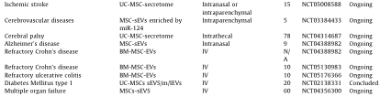
Advanced Regenerative Medicine Strategies
Emerging Cutting-edge Methods
Mesenchymal Stem Cells Secretoma
The regenerative potential of MSCs is not their differentiation, with in vivo data revealing transient and low engraftment rates,. Instead, MSCs therapeutic effects are mainly attributed to its secretome, i.e., paracrine factors secreted by these cells, further offering a more attractive and innovative approach due to the effectiveness and safety of a cell-free product (without the complexities associated with live cell transplantation).
Soluble factors (growth factors, cytokines, chemokines, and hormones) and non-soluble factors contained in extracellular vesicles (EVs)

Slide 36
Advanced Regenerative Medicine Strategies
Emerging Cutting-edge Methods
Exosome Therapy
Nanoscale biologic mediators carrying bioactive and signal molecules such as proteins, lipids, and nucleic acids between cells. Released by nearly all cell types, can be isolated from a wide range of biological fluids containing blood, urine, saliva, milk, and tear .
Have low immunogenicity, resulting in reduced immune clearance and a long half-life
Regulatory T cells (Treg)-derived exosomes (Treg-Exos) control mucosal damage, reduce migration of inflammatory cells into the intestine, improve the intestinal barrier function; modulate the inflammation, macro- phage, dendritic cells, T cells, and gut microbiota; and enhance the proliferation of intestinal stem cells.
?
PROPER DELIVERY METHOD
Via hydrogel
Direct Injection to target site
Intravenous
Orally
Costs for isolation, purification and storage

Slide 37
Mesenchymal Stem Cell-Derived Exosomes for Complex Perianal Fistula: a systematic review and single-arm meta-analysis
Cheng et al., 2025
Revista Española de Enfermedades Digestivas
Systematic Review + Meta-analysis - 3 studies included
  Healing rate: ~57%
  Clinical response: ~86%
  No major adverse events
  Limitation: small heterogeneous studies
“Exosomes are not just experimental — they already show clinically meaningful healing rates with an excellent safety profile.”

Slide 38

Take Home Messages
DON’T
Place “cutting seton”.
Neglect luminal disease (coloproctitis)
Think @ MSC and MFat as a Pixie’s Dust
Don’t Waste Time (and money ….) if sepsis is uncontrolled
!!!!!

Slide 39
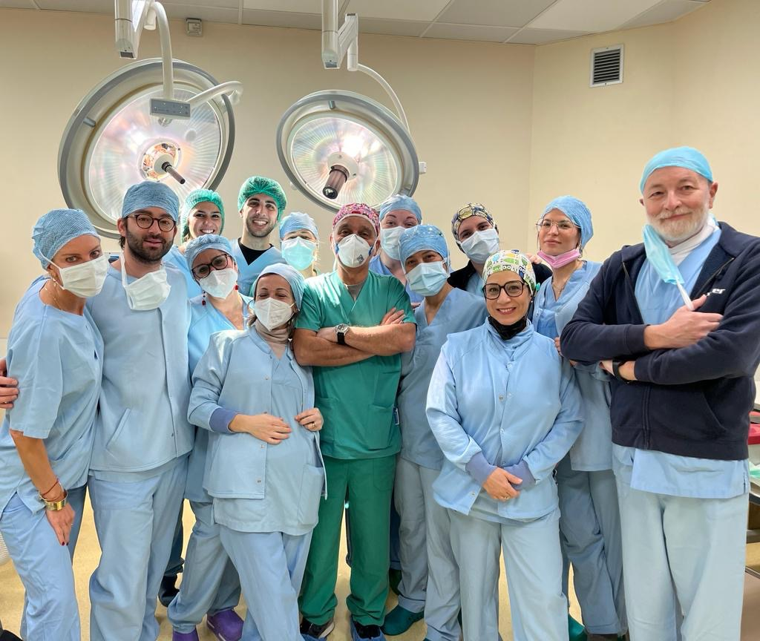
Thanks for your attention
silvio.laureti2@unibo.it

